Slide 1

Overview oF BIO EL

Slide 2
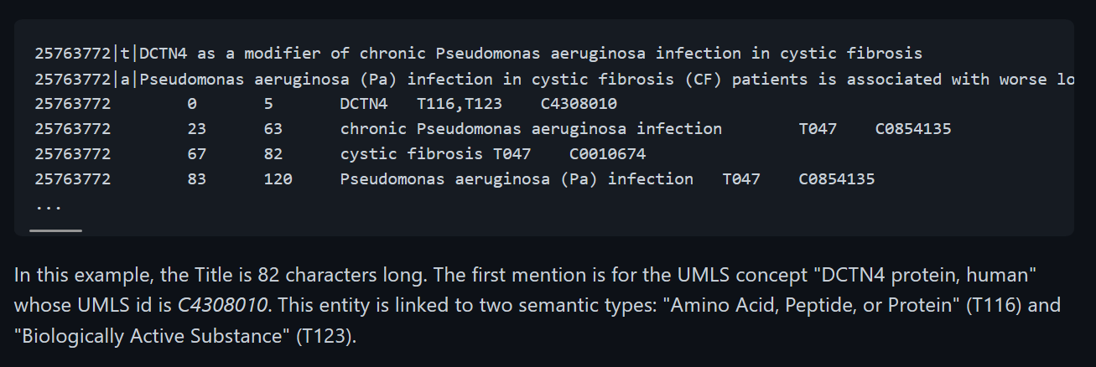
Med-mention dataset

Slide 3
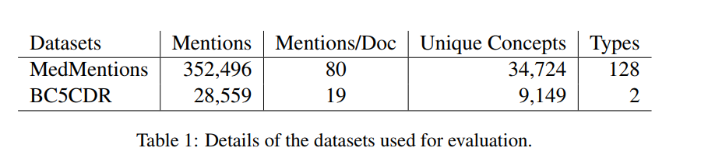
Data sets

Slide 4
Knowledge Base (UMLS )
Collection of Tables.
MRCONSO : CUID (Specific ID) , Definition , Synonyms ( lexical term ) mapping
MRSTY : Semantic type ID (T-116, T-117), Synonyms mapping
MRREL : Relation between Semantic Types ( Can be used to find concepts of any specific Semantic Type )

Slide 5
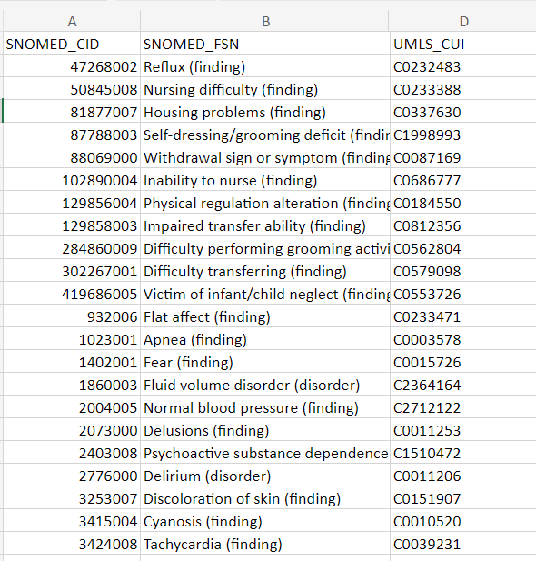
SNOMED – UMLS Mapping of a Subset of SNOMED -CT

Slide 6
Problems in Bio EL
Multiple Surface Names for any concept like :
Very large and rare mentions like : RimabotulinumtoxinB , AbobotulinumtoxinA , which are not present in general domain.
Compound mentions like : "Acquired immunodeficiency syndrome (AIDS) " , "Ebola haemorrhagic fever".
Ambiguity in Semantic type of mentions.

Slide 7
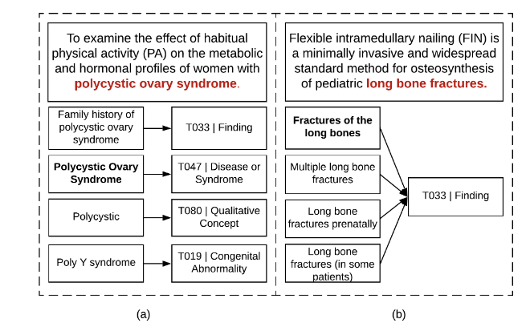
Semantic type ambiguity

Slide 8
Fast and Effective Biomedical Entity Linking Using a Dual Encoder
Pub : APR 21 , ACL

Slide 9
Abstract
Uses a BERT based retrieve and rerank paradigm , candidate entites(concepts) are selected using a retriever model, then from these retrieved candidates, ranking is done to get the best candidate.
Problem : Slow at training and test time. They process only one mention at a time.
Solution : One shot training using Bert based dual encoder ( one for mention , one for concept ) that resolves multiple mentions in a document in one shot.
Idea is to use collective entity linking , that processes entire document only once , all entities are linked in one pass.

Slide 10
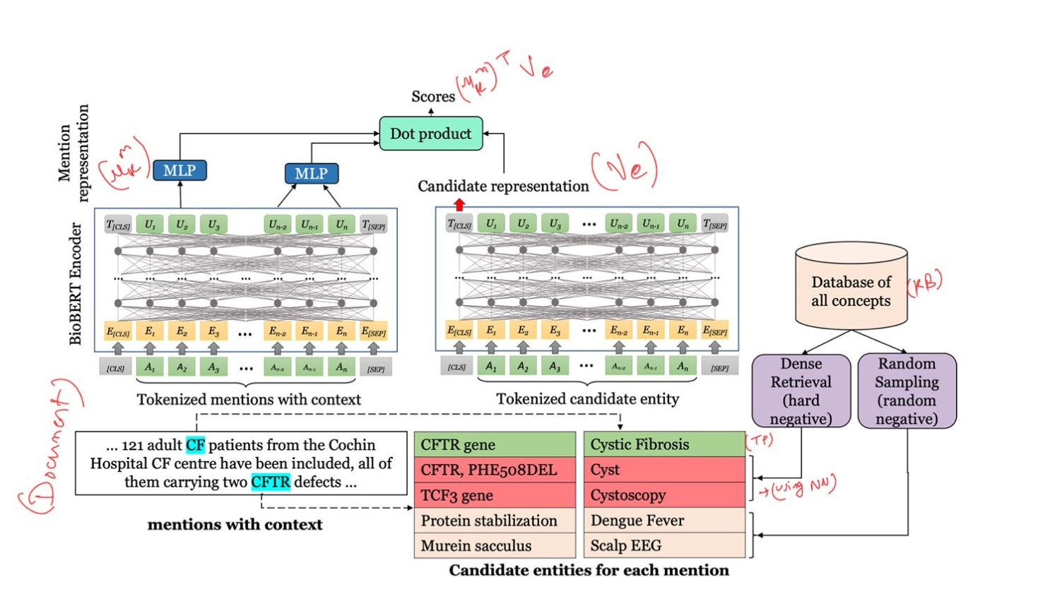
Model

Slide 11
Mention Encoder
Given an input text document of T tokens with M mentions, the output of the final layer of the encoder, denoted by [hi; : : : ; hT], is a contextualized representation of the input tokens.
For each mention span (i; j), we concatenate the first and the last tokens of the span and pass it through a linear layer to obtain the representations for mention ‘k’ as : Um(k)= W[hi; hj] + b:
The model uses a self attention so every mention in a document captures contextual info of all other mentions in document.

Slide 12
Candidate Encoder
UMLS concept names are the candidate entities.
Given an input candidate entity e = [y1; : : : ; yT ] of T tokens, the output of the final layer corresponding to the [CLS] token yields the representation for the candidate entity.
We denote this rep as Ve.

Slide 13
Candidate Selection
We use random Negative Sampling and hard negative sampling.
HNS is obtained by performing NN search btw mention and all KB Entities
The hard negative candidates are the entities that are more similar to the mention than the gold target entity .
This is done only during training and for testing all entities are used.

Slide 14

Scoring
The retrieved set of candidate entities Ck : {c1, c2,…cT } of each mention mk are scored using a dot product between the mention representation Um(k) and each candidate representation Vc.
Formally, for each c in Ck :
We use cross-entropy loss to maximize score of gold target ent.

Slide 15

Inference
During Inference : Rep of all entites (concepts) of KB are precomputed and cached.
The inference task is finding the maximum dot product between each mention representation and all entity representations :

Slide 16
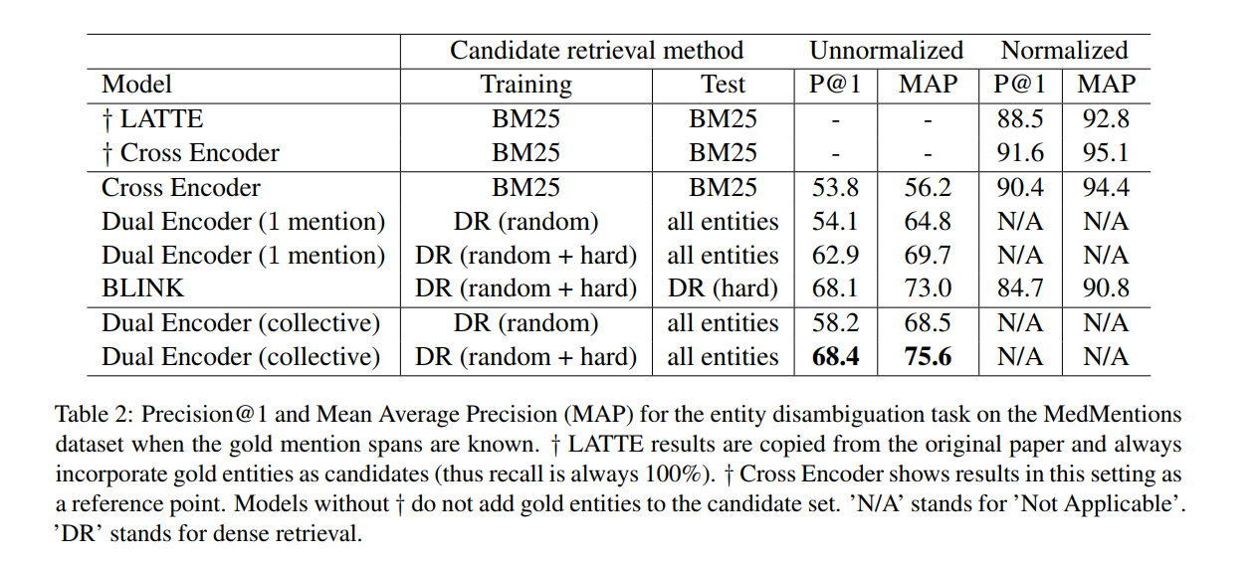
Results

Slide 17
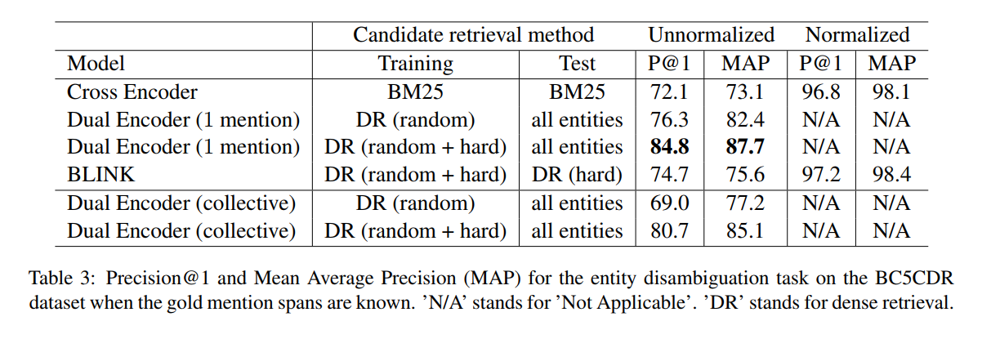
Results

Slide 18
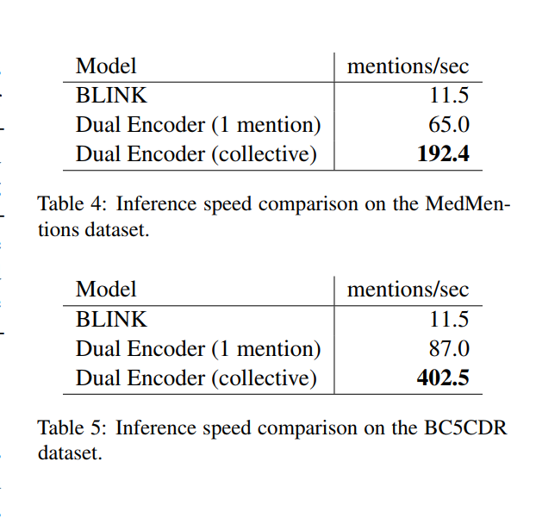
Speed
We observe that our collective dual encoder model is 3-4x faster than the single-mention Dual Encoder model and up to 25x faster (on average over the two datasets) than BLINK .

Slide 19
Observations
Dense retrieval of candidates improves the accuracy of entity disambiguation models .
For the MedMentions dataset, our collective dual encoder model outperforms all other models, while being extremely time efficient during training and inference .
Our model compares favorably against the state-of-the-art entity linking model BLINK on both datasets.
Hard negative mining is essential for the model for better entity disambiguation.

